Slide 1


Comparison of 3 Algorithmic Trading Strategies on the MetaQuotes 5 Trading Platform
Prepared by : Aymen Tilili
Academic term : 2021/2022
Supervising professor : Bassem Ben Hamed

Slide 2
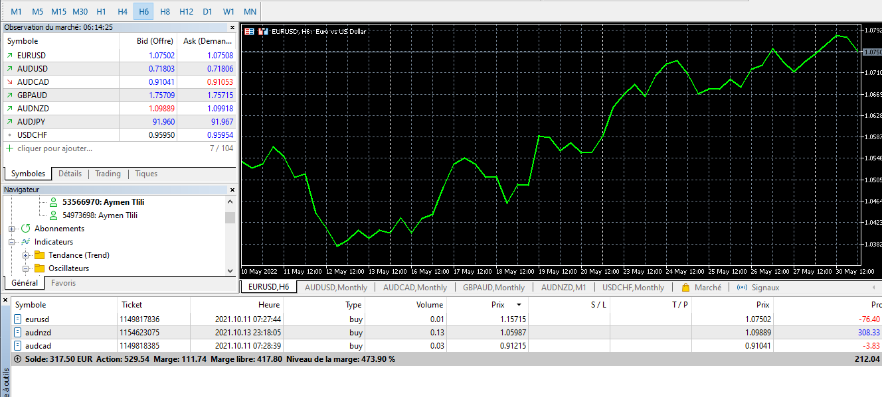
Introducing Algorithmic trading on MetaQuotes

Slide 3
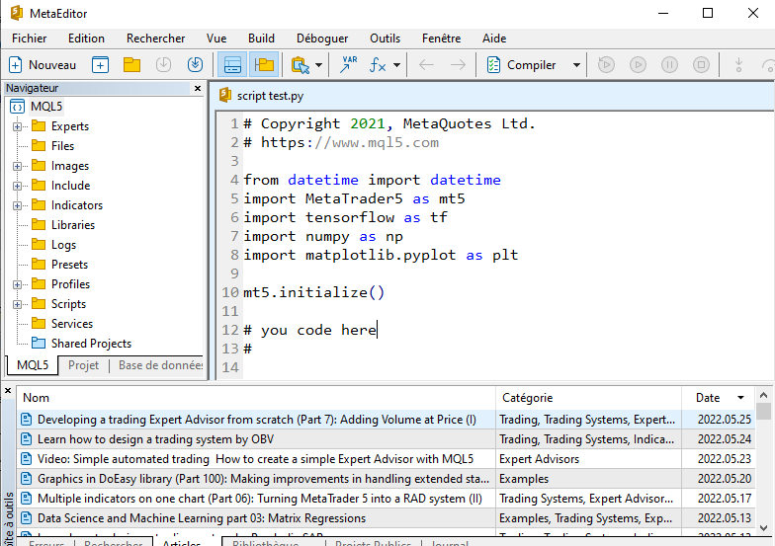
Writing our own Expert Adviser

Slide 4
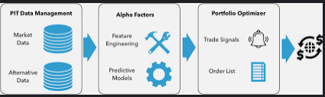
But with a Twist !

Slide 5
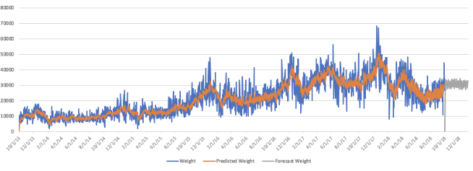
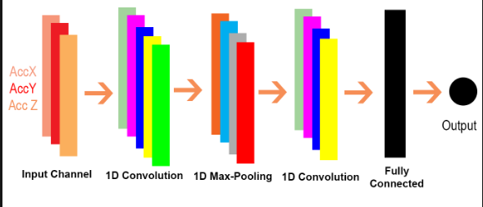
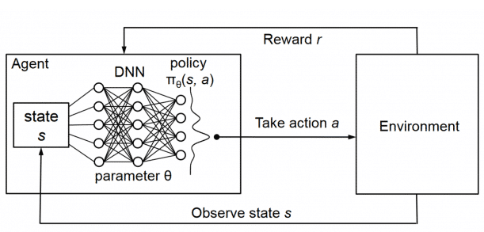
The models chosen
SARIMAX
1D input CNN
Reainforcement Learning :
Q Learning

Slide 6






the Currency pairs
GBP/AUD
JPY/CHF
USD/EUR

Slide 7
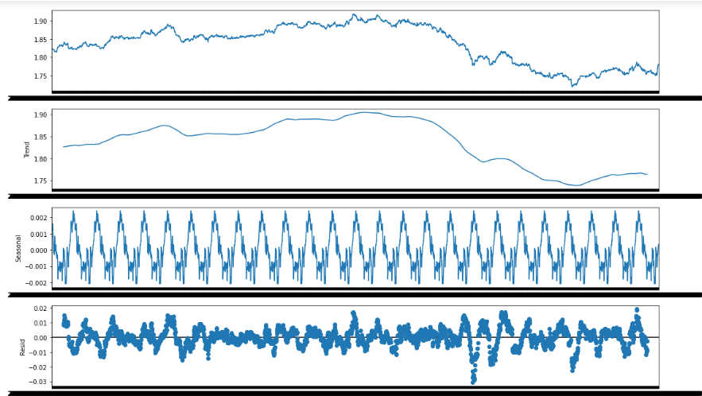
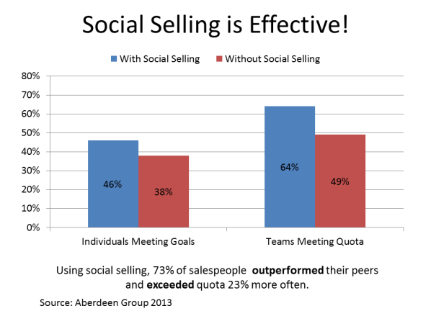
The Time-Series Model

Slide 8
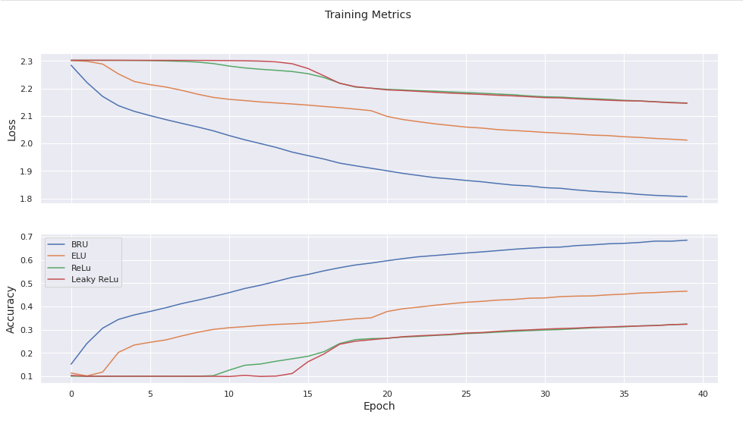
The CNN model
Different Activation Functions

Slide 9
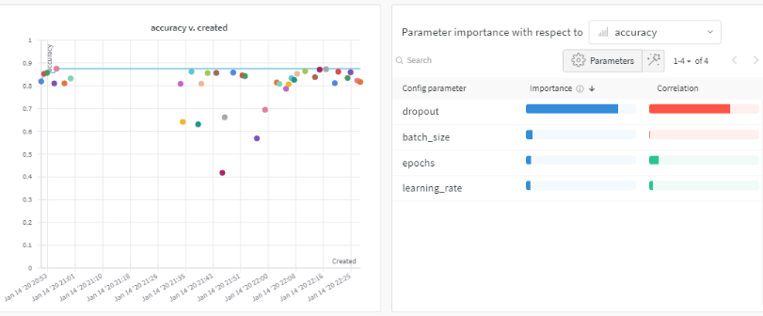
The CNN model
Hyper parameter optimization :

Slide 10
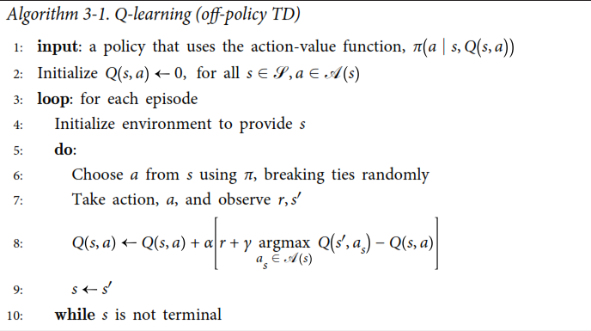
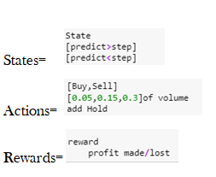
The Q Learning Model

Slide 11
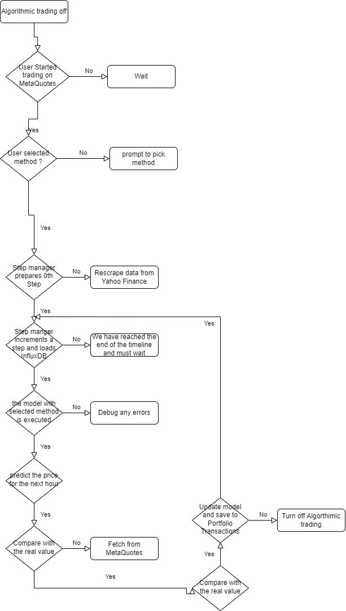

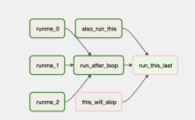
Creating Pipelines

Slide 12
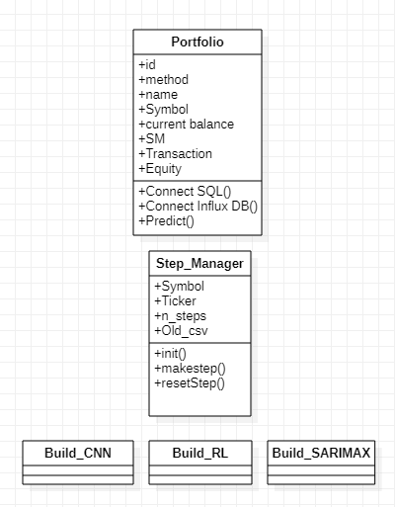
Managing the portfolios automatically

Slide 13



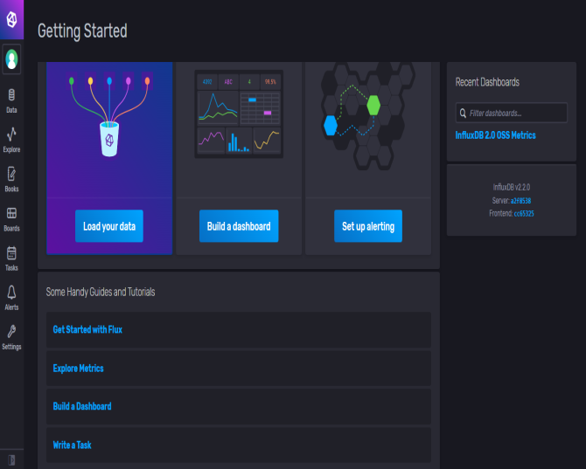
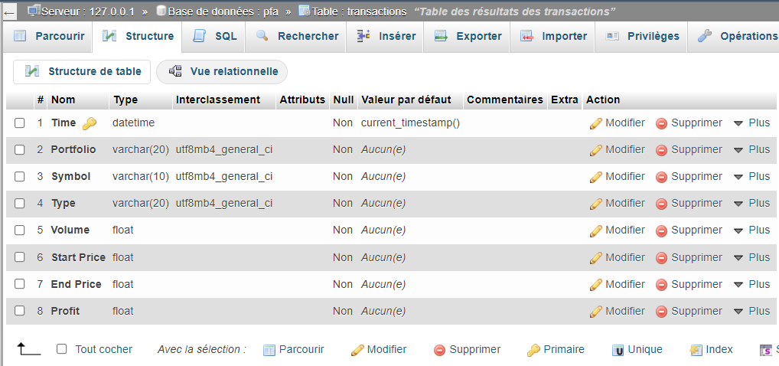
Using the appropriate Data bases

Slide 14
Merci pour Votre Attention !

